Slide 1




PDS
Computer Vision
The Docker platform
https://github.com/siagianp
https://www.youtube.com/@AmelOline/videos
The Docker platform
https://github.com/amelcharolinesgn2/IoT_simulator-mqtt-NodeRed
https://github.com/amelcharolinesgn2/Cloud-Infrastructures
https://github.com/amelcharolinesgn2/ClouD-Infrastructure-SISKA-2025
Notes:
https://docs.docker.com/get-started/docker-overview/

Slide 2
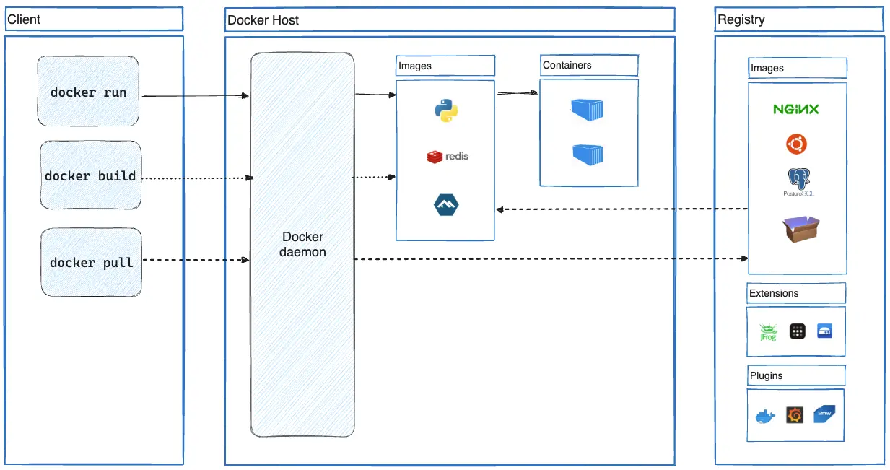


A Cargo Ship…
Carries containers across the sea
Notes:
https://docs.docker.com/get-started/workshop/04_sharing_app/

Slide 3
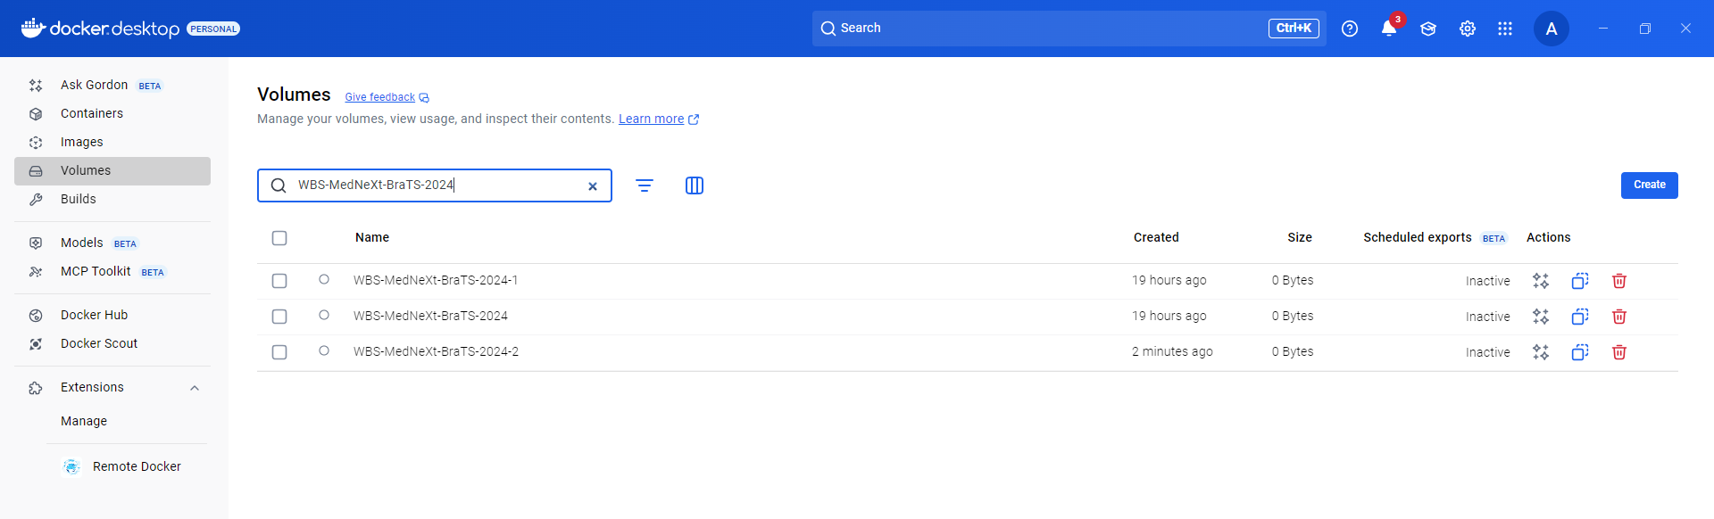
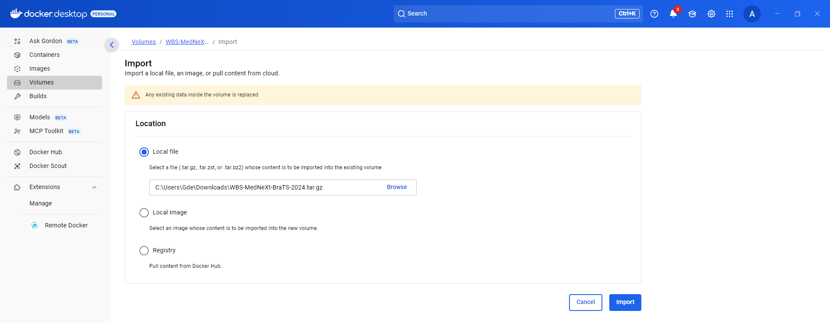
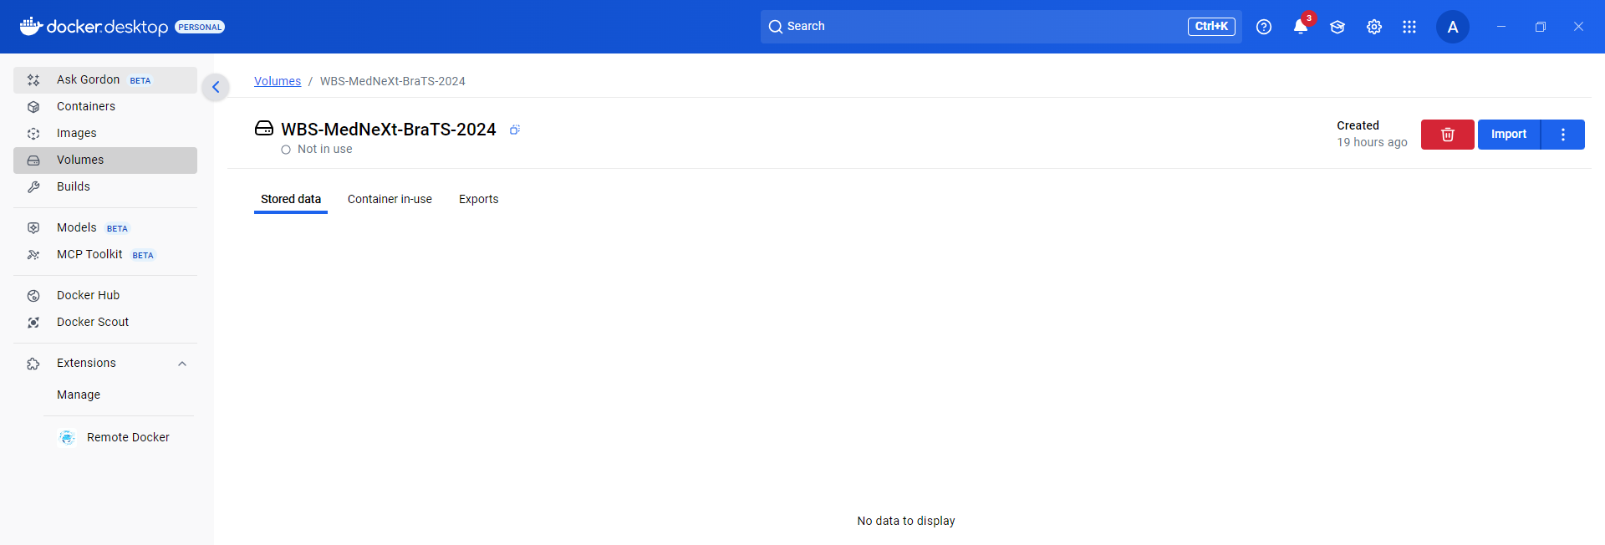
Optimizing Brain Tumor Segmentation with MedNeXt: BraTS 2024 SSA and Pediatrics

Slide 4
https://github.com/JotatD/med-ddpm-brats
🚀 Run on Your Own Dataset
Med-DDPM is versatile. If you're working with image formats other than NIfTI (.nii.gz), modify the `read_image` function in `dataset.py`.
Specify the segmentation mask directory with `--inputfolder`.
Set the image directory using `--targetfolder`.
If you have more than 3 segmentation mask label classes, update channel configurations in `train.py`, `datasets.py`, and `utils/dtypes.py`.
📋 ToDo List
Your contributions to Med-DDPM are valuable! Here's our ongoing task list:
Main model code release
Release model weights
Implement fast sampling feature
Release 4 modality model code & weights
Deploy model on HuggingFace for broader reach
Draft & release a comprehensive tutorial blog
Launch a Docker image
🚀 Run on Your Own Dataset
Med-DDPM is versatile. If you're working with image formats other than NIfTI (.nii.gz), modify the `read_image` function in `dataset.py`.
Specify the segmentation mask directory with `--inputfolder`.
Set the image directory using `--targetfolder`.
If you have more than 3 segmentation mask label classes, update channel configurations in `train.py`, `datasets.py`, and `utils/dtypes.py`.
Image Dimensions
Whole-head MRI synthesis: 128x128x128
Brain-extracted 4 modalities (T1, T1ce, T2, Flair) synthesis (BraTS2021): 192x192x144
https://editor.p5js.org/fepegar/sketches
Notes:
https://github.com/JotatD/med-ddpm-brats

Slide 5
https://github.com/openai/guided-diffusion
Here are the download links for each model checkpoint:
64x64 classifier: 64x64_classifier.pt
64x64 diffusion: 64x64_diffusion.pt
128x128 classifier: 128x128_classifier.pt
128x128 diffusion: 128x128_diffusion.pt
256x256 classifier: 256x256_classifier.pt
256x256 diffusion: 256x256_diffusion.pt
256x256 diffusion (not class conditional): 256x256_diffusion_uncond.pt
512x512 classifier: 512x512_classifier.pt
512x512 diffusion: 512x512_diffusion.pt
64x64 -> 256x256 upsampler: 64_256_upsampler.pt
128x128 -> 512x512 upsampler: 128_512_upsampler.pt
LSUN bedroom: lsun_bedroom.pt
LSUN cat: lsun_cat.pt
LSUN horse: lsun_horse.pt
LSUN horse (no dropout): lsun_horse_nodropout.pt
Notes:
https://github.com/JotatD/med-ddpm-brats
https://huggingface.co/blog/annotated-diffusion

Slide 6
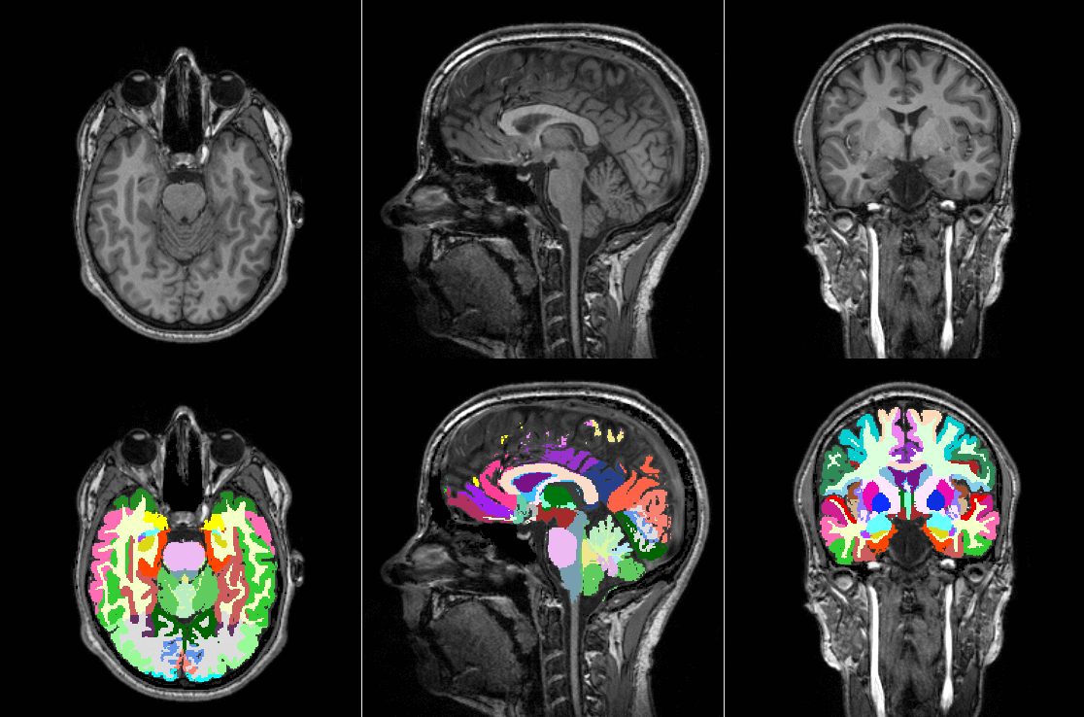
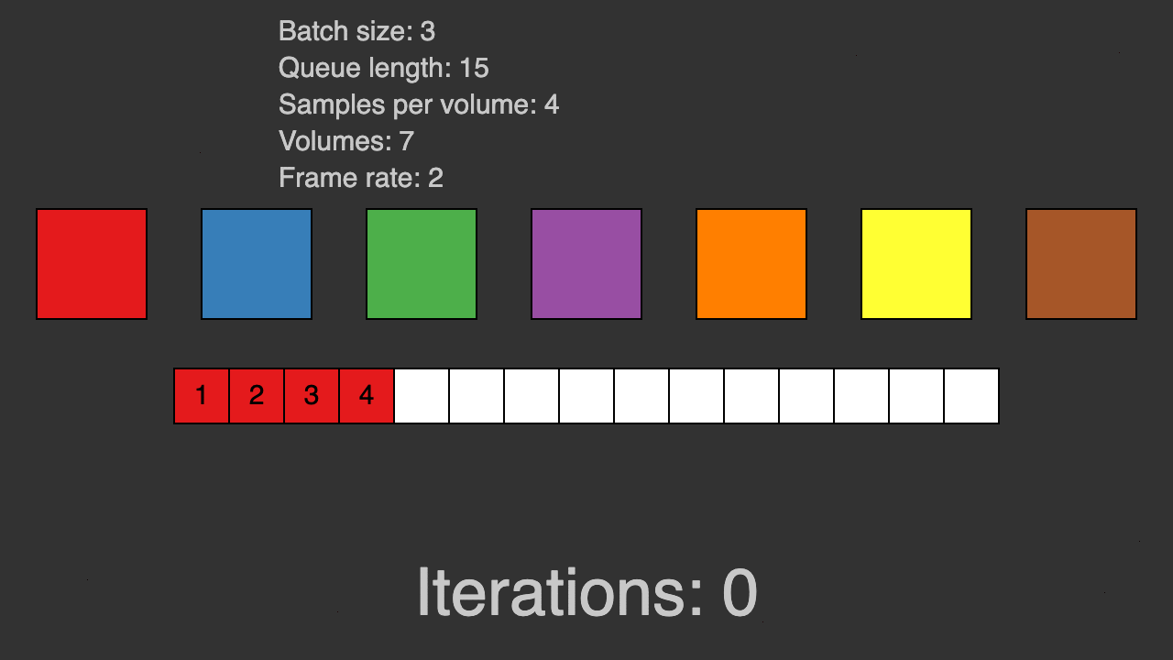
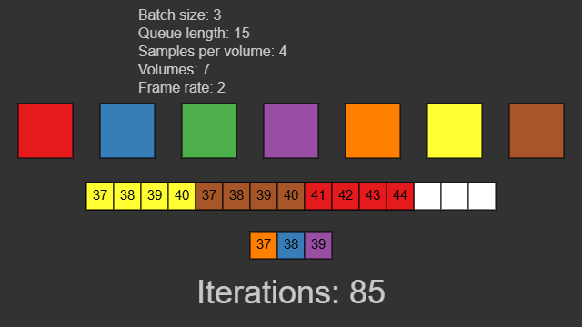
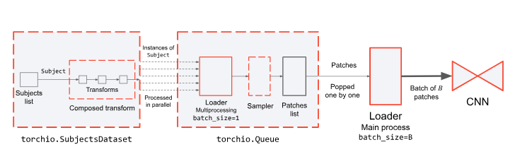
https://github.com/TorchIO-project/torchio
https://docs.torchio.org/patches/patch_training.html#queue
Patch samplers
Patch-based pipelines
https://docs.torchio.org/patches/index.html
Notes:
https://docs.torchio.org/patches/index.html
https://docs.torchio.org/patches/patch_training.html
https://github.com/TorchIO-project/torchio
https://github.com/TorchIO-project/torchio/blob/main/tutorials/README.md

Slide 7
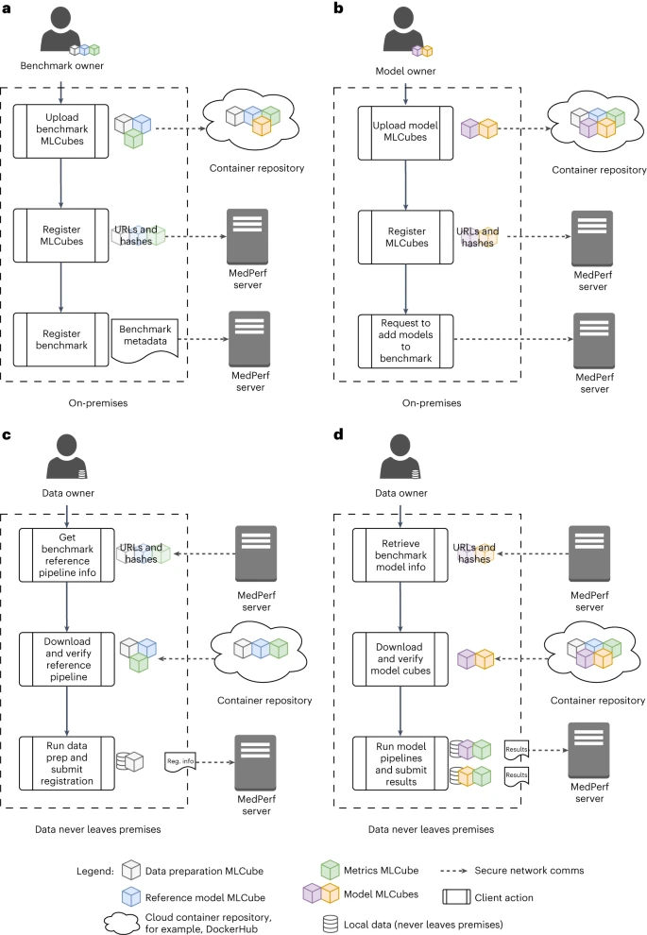
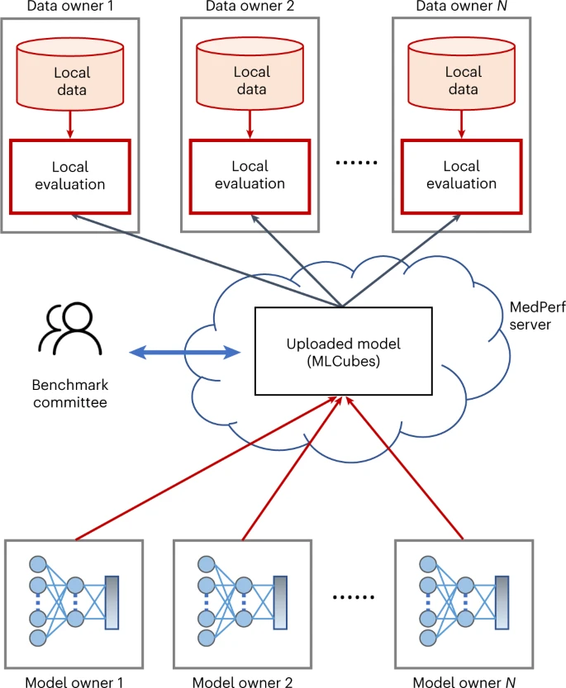
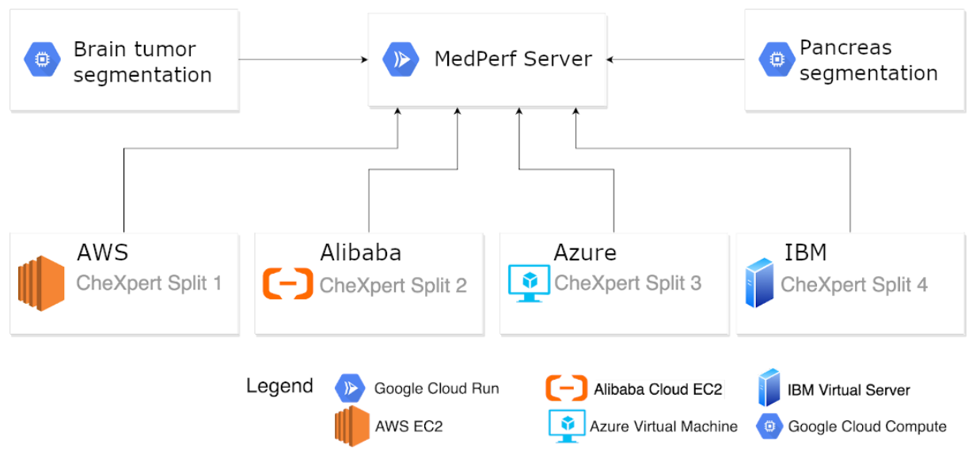
MedPerf
The figure below displays the data provider locations used in all pilot experiments. 🟢: Pilot 1 - Brain Tumor Segmentation Pilot Experiment; 🔴: Pilot 2 - Pancreas Segmentation Pilot Experiment. 🔵: Pilot 3 - Surgical Workflow Phase Recognition Pilot Experiment. Pilot 4 - Cloud Experiments, used data and processes from Pilot 1 and 2.
Their radiological appearance is described by different sub-regions comprising 1) the “enhancing tumor” (ET), 2) the gross tumor, also known as the “tumor core” (TC), and 3) the complete tumor extent also referred to as the “whole tumor” (WT). ET is described by areas that show hyper-intensity in T1Gd when compared to T1, but also when compared to ”healthy” white matter in T1Gd. The TC describes the bulk of the tumor, which is what is typically resected. The TC entails the ET, as well as the necrotic (fluid-filled) parts of the tumor. The appearance of the necrotic (NCR) tumor core is typically hypo-intense in T1Gd when compared to T1. The WT describes the complete extent of the disease, as it entails the TC and the peritumoral edematous/invaded tissue (ED), which is typically depicted by hyper-intense signal in T2-FLAIR. These scans, with accompanying manually approved labels by expert neuroradiologists for these sub-regions, are provided in the International Brain Tumor Segmentation (BraTS) challenge data.
Notes:
https://github.com/mlcommons/medperf
https://github.com/mlcommons/medperf
http://camma.u-strasbg.fr/
https://www.nature.com/articles/s42256-023-00652-2

Slide 8
Thank you.
Q&A

